Slide 1

Time Series case study
Name: Pranali Kanade

Slide 2
Case study
Chinese pharma is dominating in market with its product Noto37 targeting cholesterol/blood pressure market segment
Hong Kong market accounts 95% of company’s sale.
Noto37 capturing 40% of market share for its market segment
Increased Awareness of major health issues via media, TV and internet in Honk Kong
Notoginseng main ingredient of Noto37 available at cheaper price in spring and winter
Peak sales during winter months by up to 50% and decrease during spring by up to 50%
Inventory management utilizing leased based storage space

Slide 3
Problem statement
Forecasting of company sales for better planning of inventory management, raw material and testing to increase overall revenue
Avoiding stock out Noto37 during peak winter sales
Unhappy retailers because of frequent stock outs
Possibility of reduced market demand because of increased competition

Slide 4
Strategies to avoid stock out
Request purchasing manager to inform about possible stock out in advance
In case of stock out possibility speed up the testing process and get faster deliver of Notoginseng for small quantity to deliver product faster
Automate processes for faster processing of order, testing and deliveries
Manage inventory by varying the contract duration for peak season and slow season

Slide 5
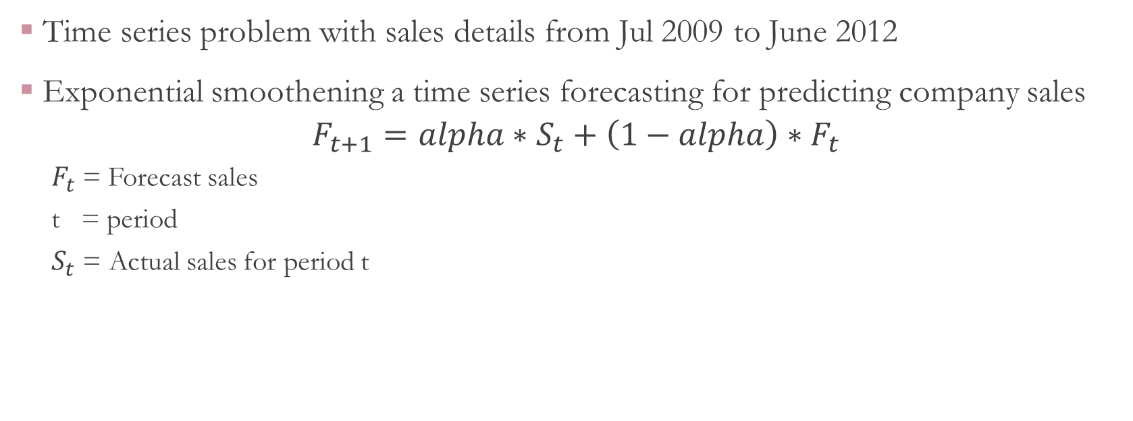
Forecasting solution for sales
Time series problem with sales details from Jul 2009 to June 2012
Exponential smoothening a time series forecasting for predicting company sales
$$F_{t+1}=alpha∗S_{t}+\left(1−alpha\right)∗F_{t}$$
$F_{t}$= Forecast sales
t = period
$S_{t}$ = Actual sales for period t

Slide 6
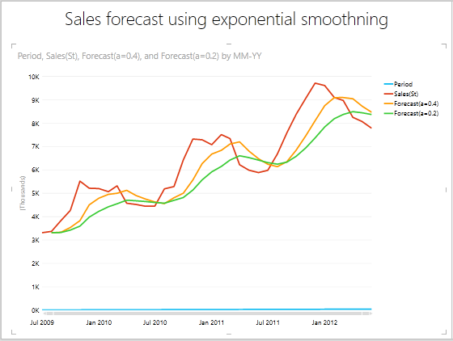
Sales forecasting result for alpha 0.4 and 0.2

Slide 7
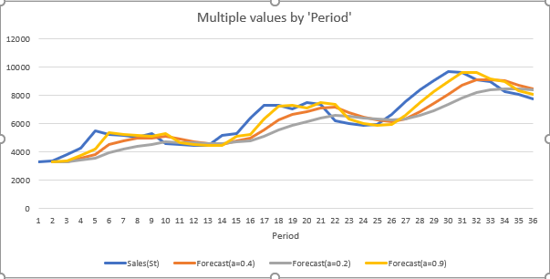
Sales forecasting result for alpha 0.4, 0.2 and 0.9

Slide 8
Exponential Smoothening Model accuracy
Model 1:
Alpha=0.4
MSE=862.96
Model 2:
Alpha=0.2
1120.49
Model 3:
Alpha=0.9
579.13

Slide 9
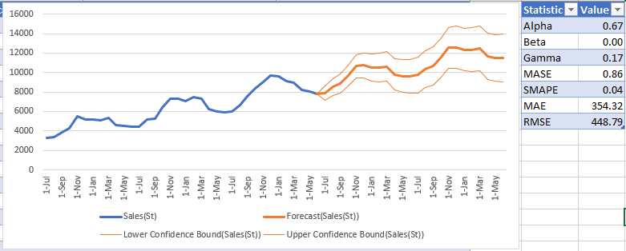
Forecast sheet using Excel

Slide 10
Excel forecast sheet result
Inbuilt Excel forecast sheet model accuracy:
Alpha: 0.67
RMSE: 448.79

Slide 11
Recommendation
Make advertisement in Hong Kong to promote Noto37 as 95% of market share is there
Plan Increased inventory and purchase of Notoginseng for winter season as sales increase by up to 50%.
Reduce inventory and purchase of Notoginseng for spring season and bring it to moderation during summer
Implementation of forecast model for sales and inventory
Offer sales on product during spring season to boost the sales of product

Slide 12
References
https://hbsp.harvard.edu/product/ST5-PDF-ENG
https://www.essay48.com/case/22246-Chinese-Pharmaceuticals-HK-Limited-Effective-Forecasting-for-Optimal-Inventory-Management-Case-Solution
https://www.case48.com/case-solution/22246-Chinese-Pharmaceuticals-HK-Limited-Effective-Forecasting-for-Optimal-Inventory-Management

